Slide 1
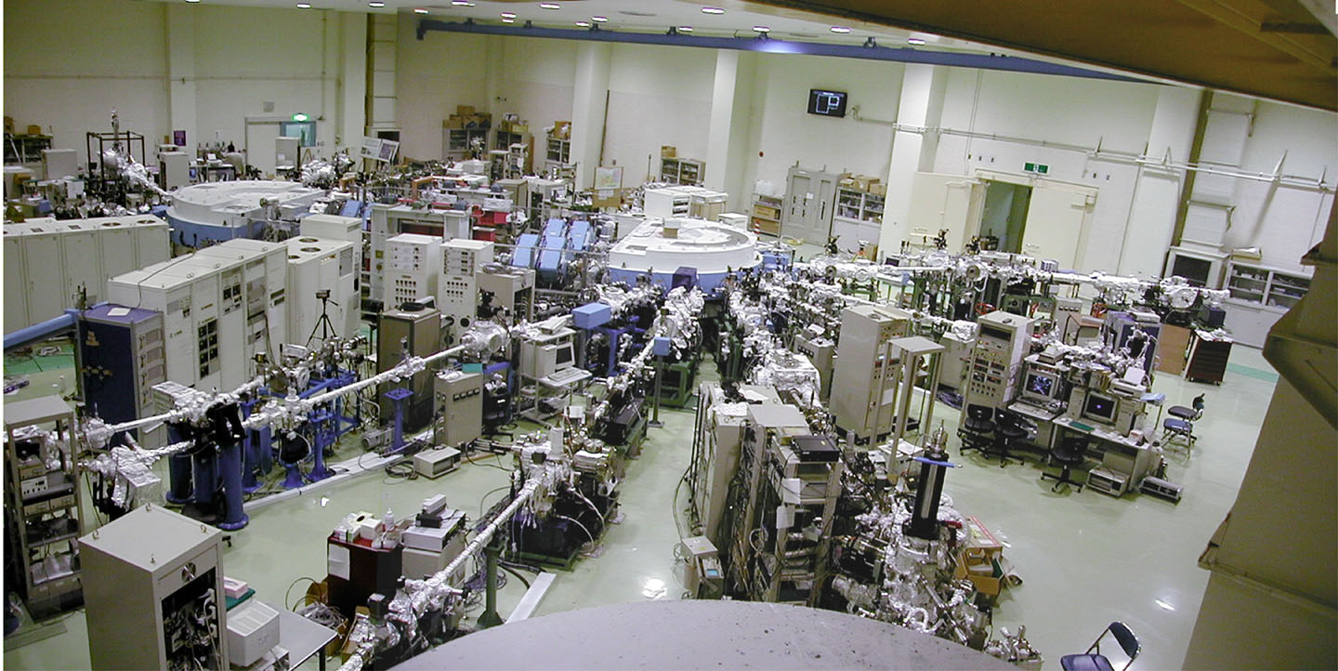
極低エネルギーで見るバルク電子状態
広島大学 谷口雅樹

Slide 2

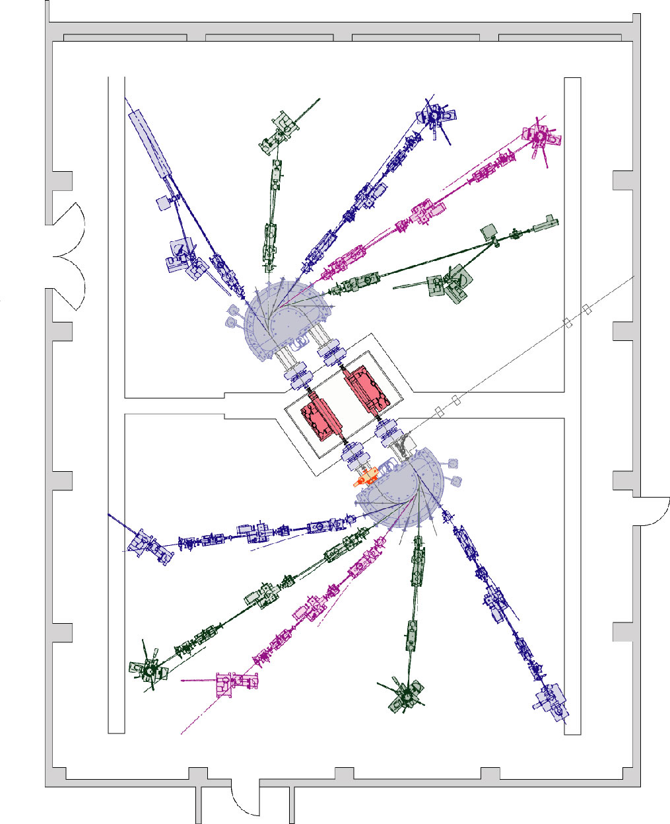
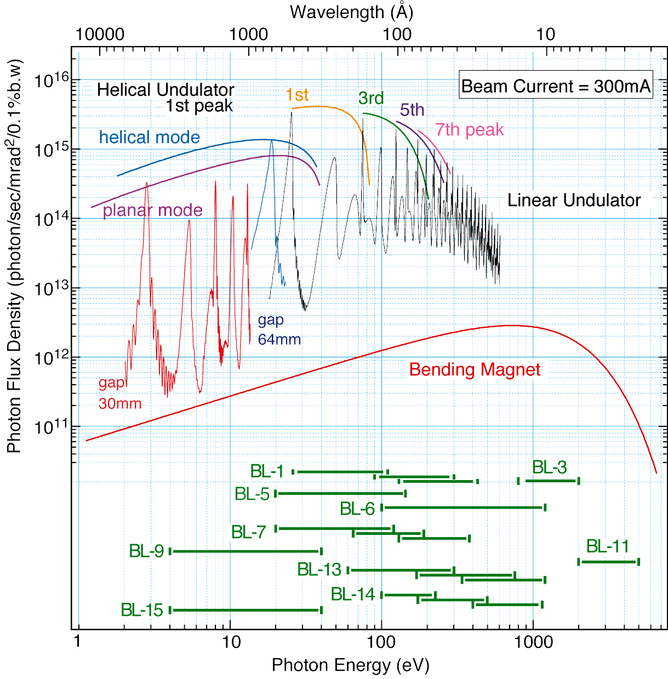
Layout of light source and beamlines
Hiroshima Synchrotron Radiation Center
Hiroshima University
BL-9
4-40 eV
Linear undulator
Helical / Linear
undulator
BL-1
26-300 eV
700 MeV
Max. current: I_{b} = 350 mA
Notes:
HiSOR has two straight sections, where Linear undulator and Helical/linear undulators are installed.

Slide 3
Advantage of Low-Energy SR Photoemission Spectroscopy
hν < 15 eV
Bulk Sensitivity
Escape depth ~ 50 Å (kinetic energy ~4 eV)
• Information intrinsic to bulk
High energy and momentum resolutions
∆E _{tot} : 600-700 μeV ∆k : 4×10⁻³Å⁻¹
• Fine structures near the Fermi level
Tunability of excitation photons
∆E _{ph} : 230 μeV @ 7 eV
• Selective observation of specific electronic
states using matrix-element effect

Slide 4
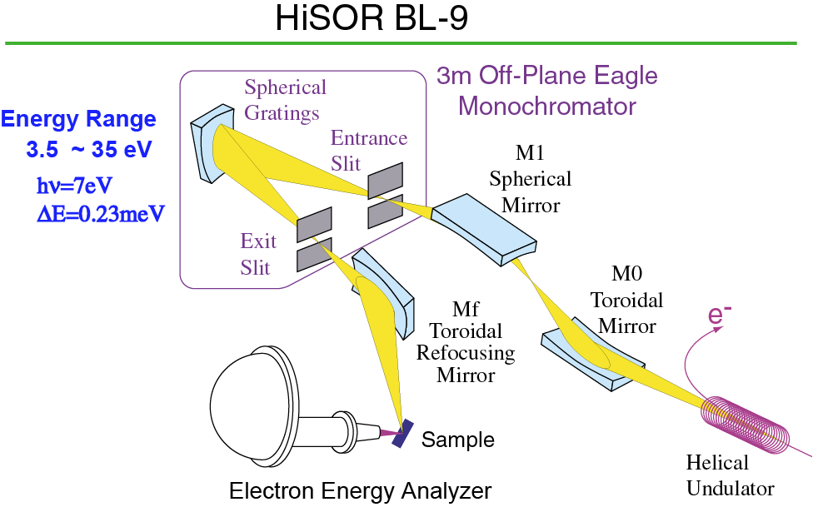

Slide 5
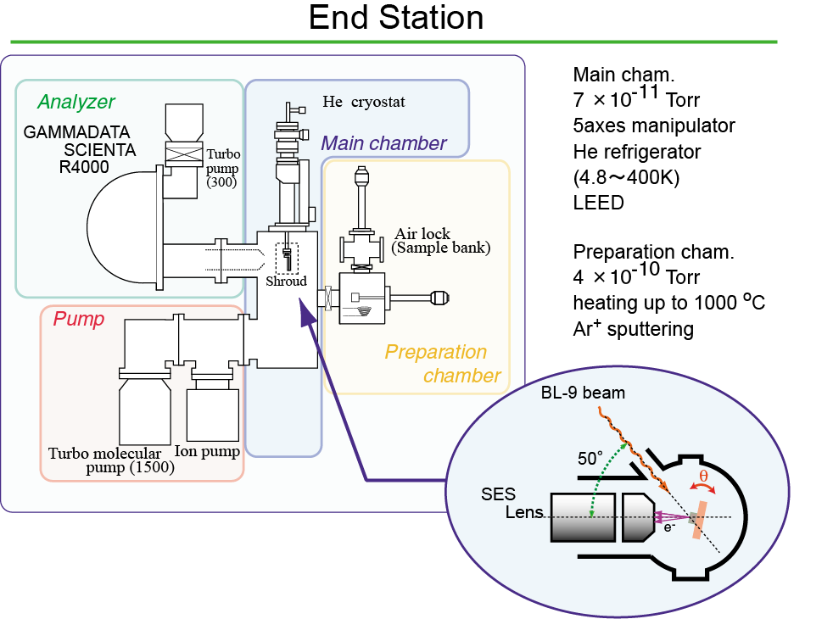
Configuration : Top View

Slide 6
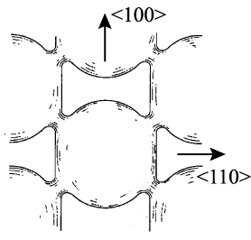
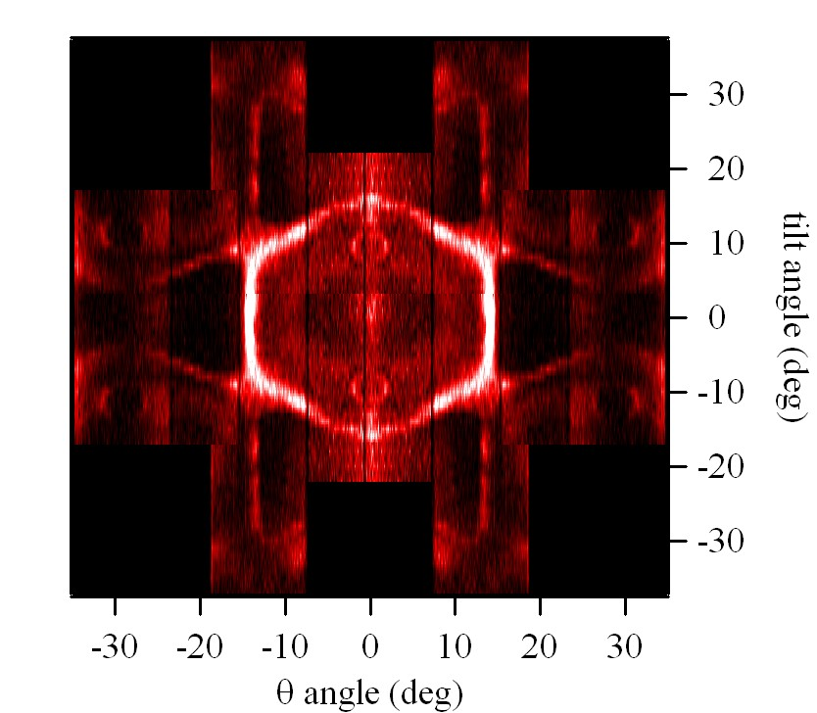
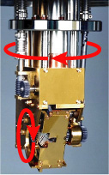
Fermi surface of Cu
θ
φ
Surface
state
5-axes manipulator
4.8 – 400 K
Calculation
hν=102 eV, DE=40 meV,
T=140 K, 120 spectra
BL-1

Slide 7
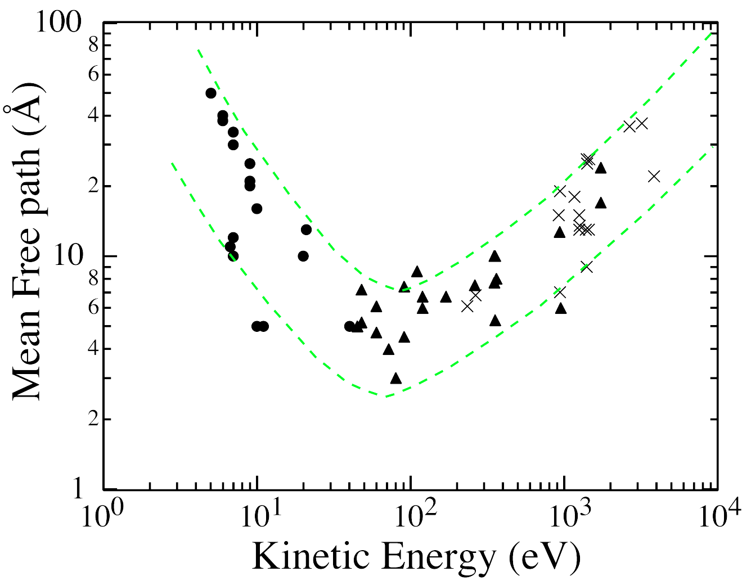
Escape Depth
3 eV
6 keV
Observation of electronic structures intrinsic to the bulk.
40 eV
Low-energy PES
Hard x-ray PES

Slide 8
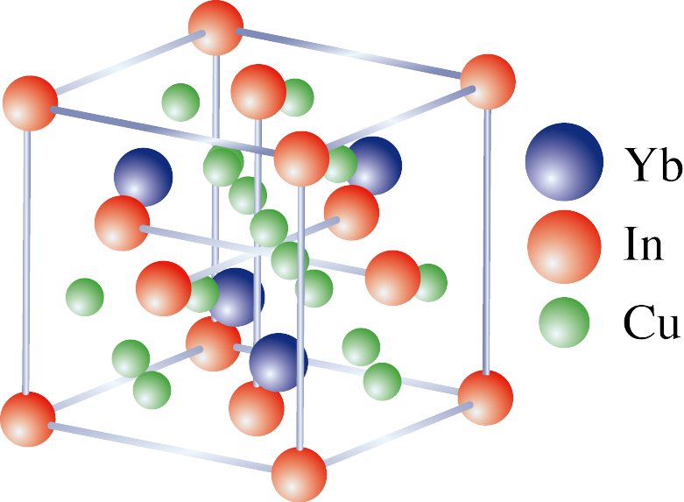
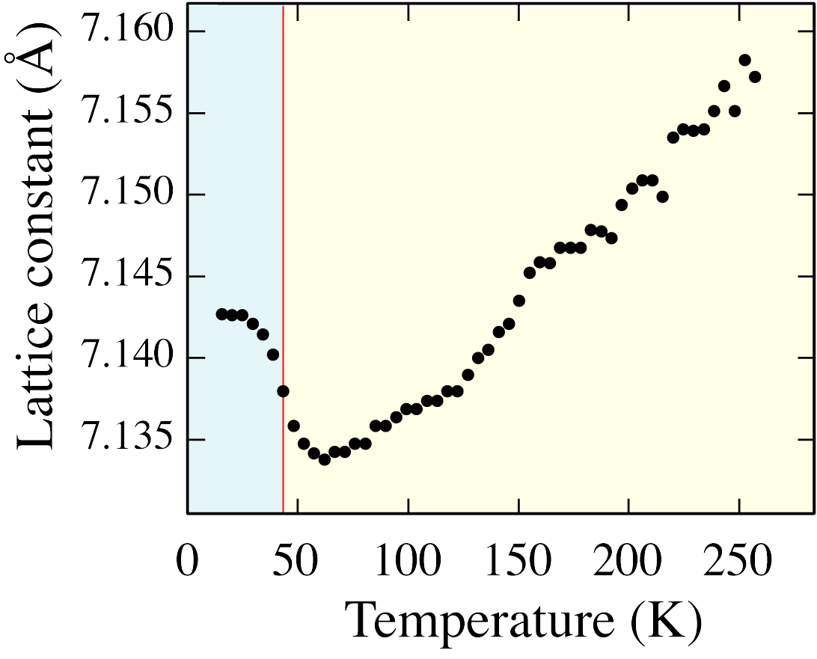
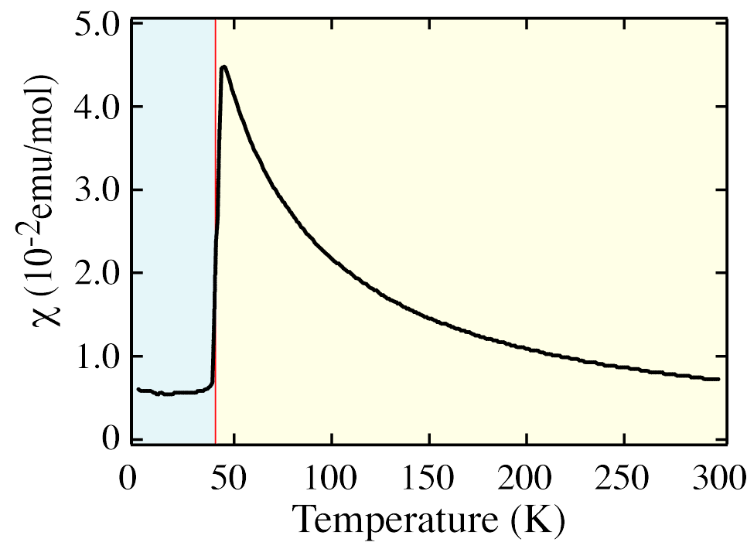
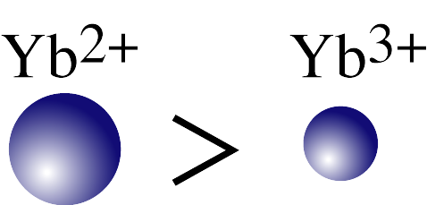
Valence transition in YbInCu₄
z~2.9
z~3
YbInCu₄
Lattice Const.
C15b-type
No change at T_{V}
T_{K}~400 K
T_{K}~25 K
YbInCu₄
Magnetic susceptibility
Curie-Weiss
Pauli-Para
Valence transition at T_{V}=42 K

Slide 9
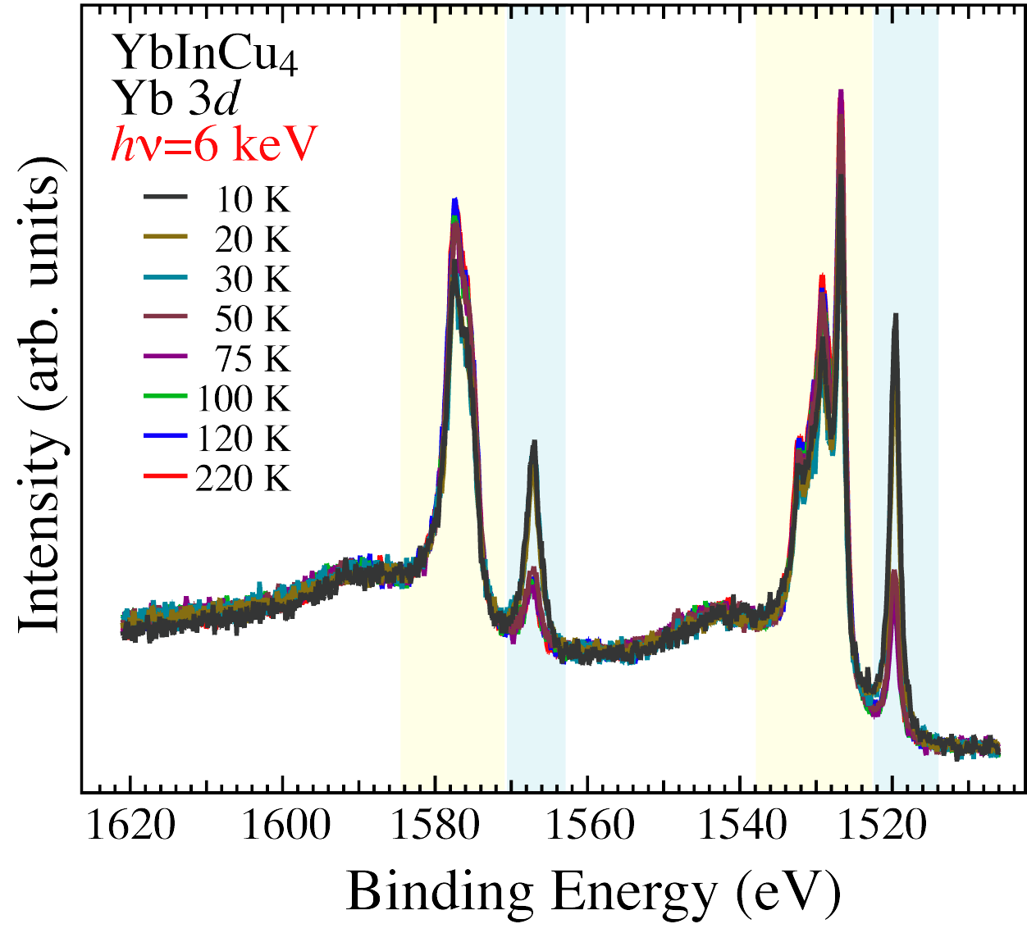
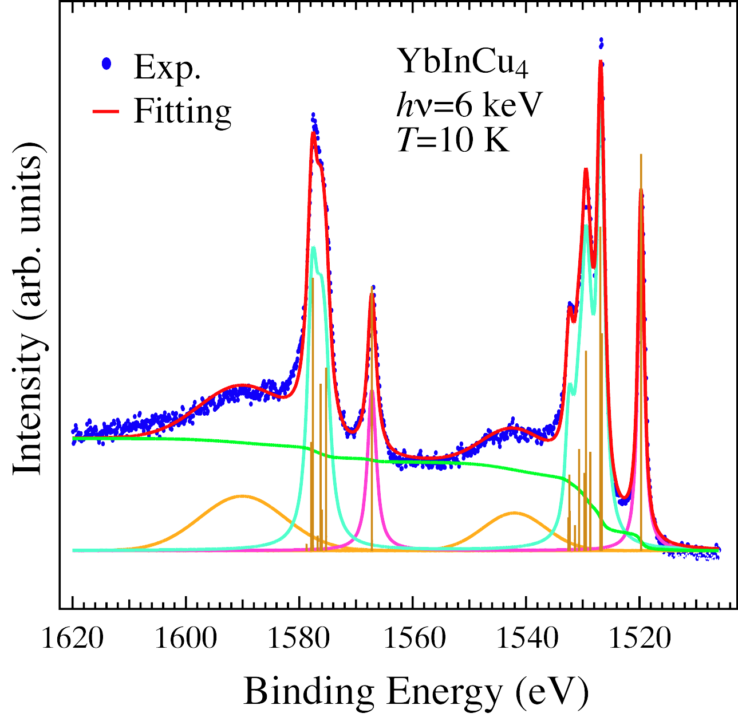
Valence Determination by Yb 3d PES Spectra
Yb 3d HX-PES
Fitting Analysis of Yb 3d HX-PES
Yb³⁺
Yb³⁺
Yb²⁺
Yb²⁺
plasmon
plasmon
3d_{3/2}
3d_{5/2}
Sharp change is observed at ~T_{V}
Notes:
Fitting analysis by means of configuration interaction

Slide 10
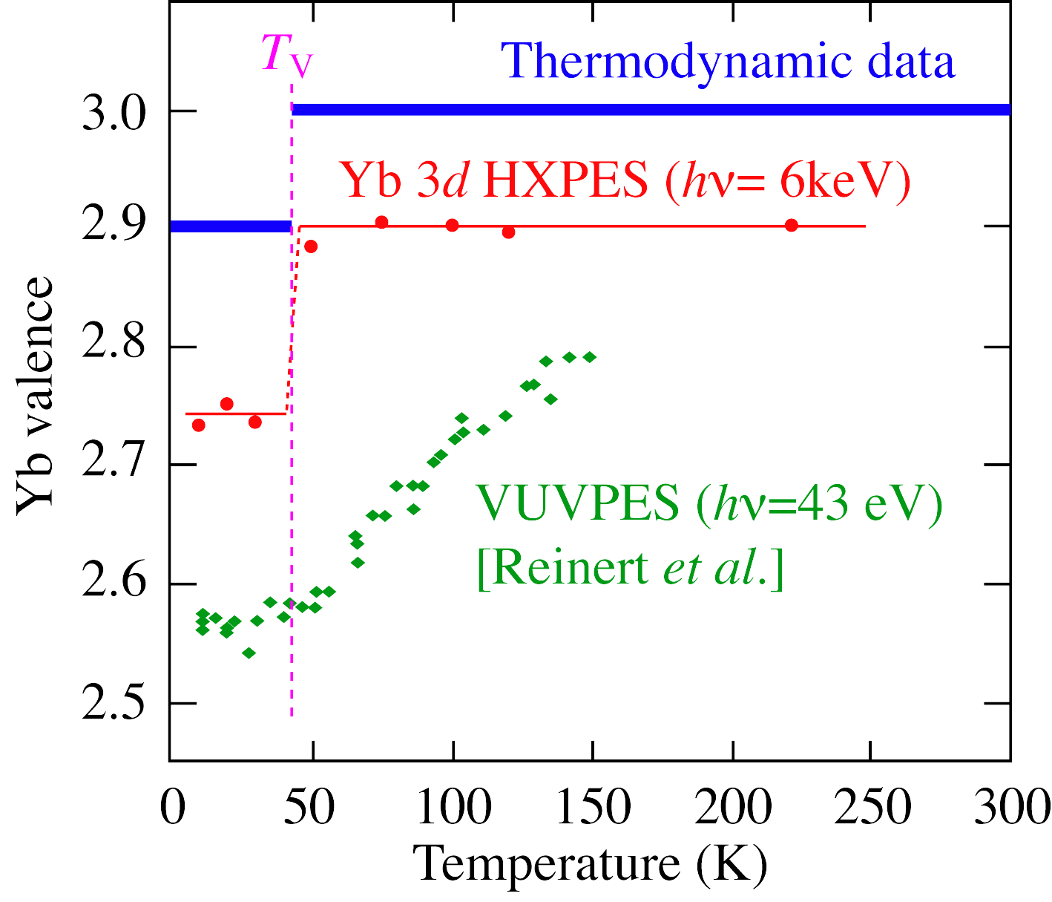

Temperature dependence of Yb valence
With increasing probing depth
change at T_{V} : sharper
Yb valence : close to 3+
λ~ 70 - 90 Å
Yb 3d HX-PES is suitable
for the Yb valence determination
λ ~ 5 Å
Gradual decrease of Yb valence in HT phase
δ~ 15 Å
surface
subsurface region
With higher T_{V}
bulk

Slide 11
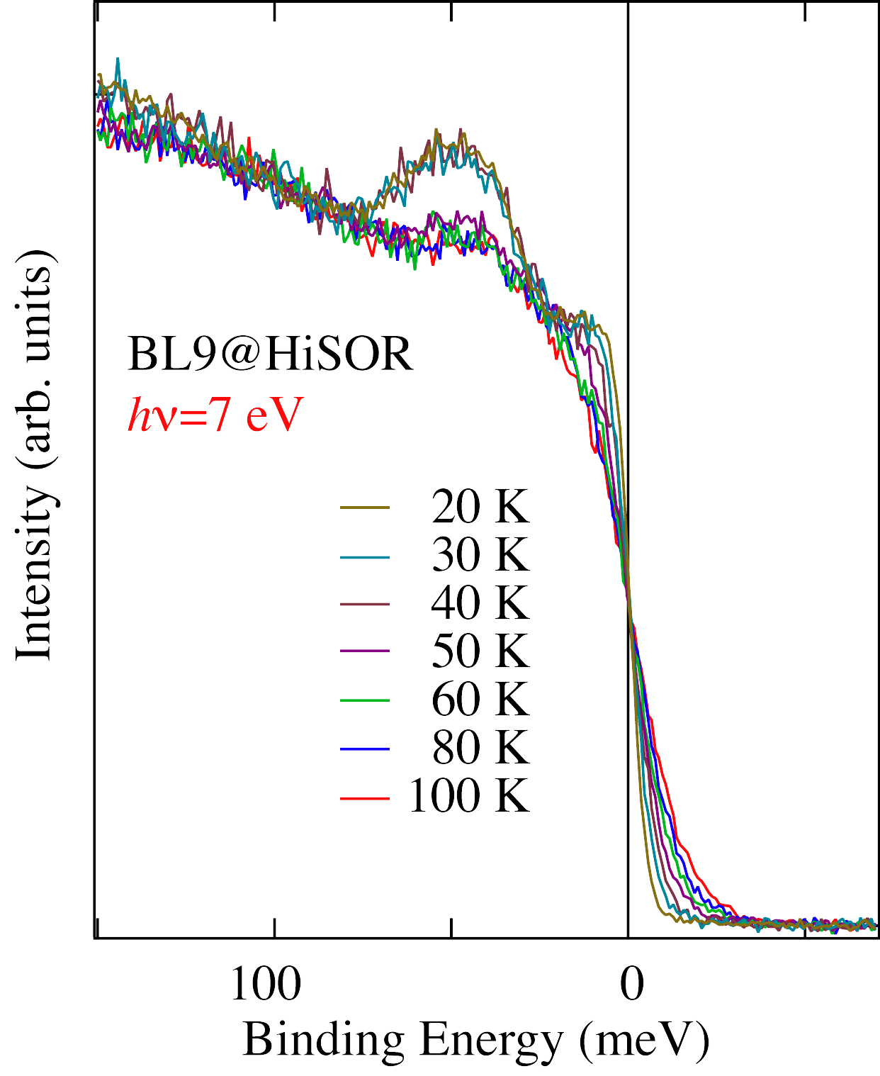
Observation of c-f hybridization
by LE-PES
Low-Temperature (LE) phase
new structure @ 47 meV
c-f hybridization increases at LT phase
( In 5p – Yb 4f )
47 meV correspond to k_{B}T_{K}
T_{K} ~ 400 K
Kondo resonance peak
λ~ 50 - 100 Å
Y_{x}Yb_{1-x}InCu₄ : x↑ , T_{K}↓

Slide 12
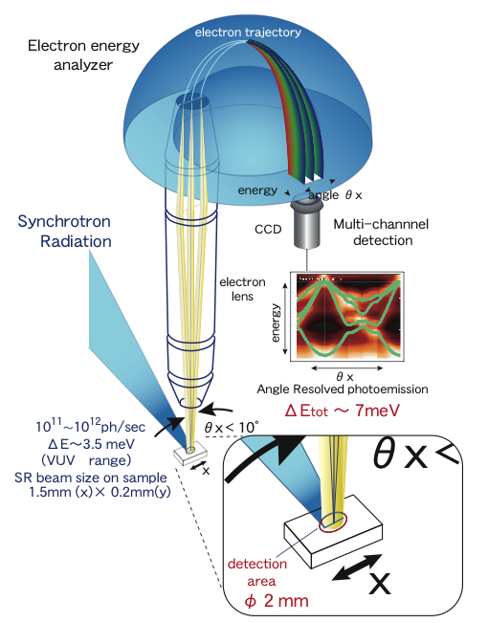
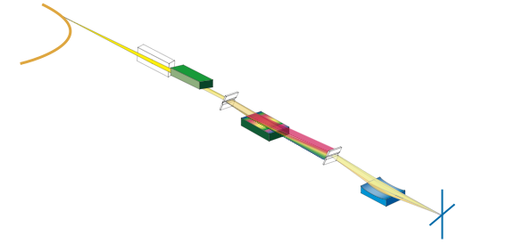
High energy resolution
Undulator
GAMMADATA
SCIENTA
R4000
Beamline
High resolution
Tunability
Polarization
End Station

Slide 13
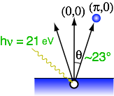
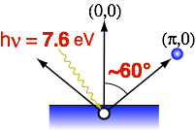

Increase of momentum resolution in ARPES using low-energy excitation photons
<Wide Emission Angle>
High momentum-resolution

Slide 14
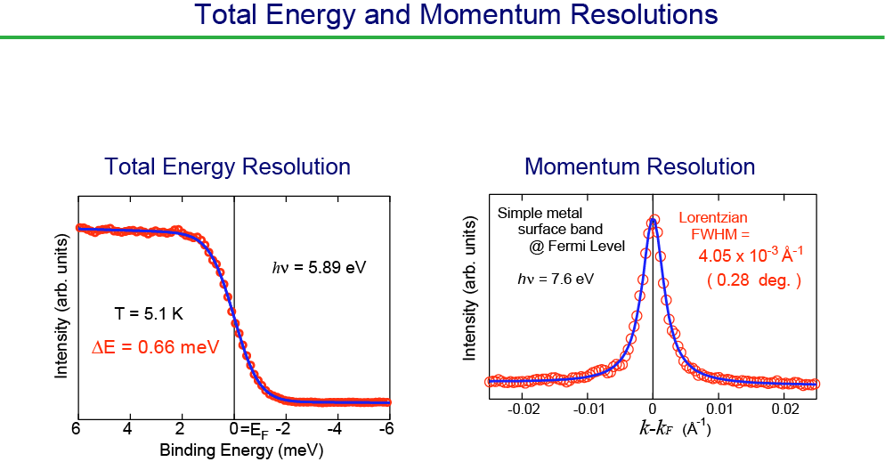
∆E _{tot} : 600-700 μeV
∆k : 4×10⁻³Å⁻¹

Slide 15
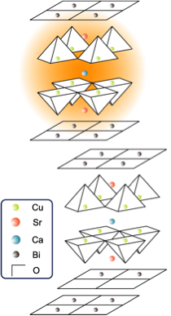
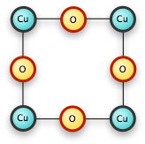
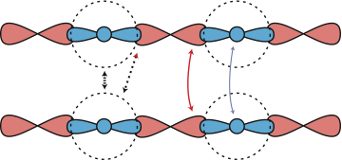
Bi₂Sr₂CaCu₂O_{8+δ} (Bi2212)
High-Tc superconducter T_{c} = 92K
2D CuO₂ plane:
the stage of
superconductivity
CuO₂ plane
O
Cu
O
Cu
O
t_{ss}
⊥
t_{pp}
t_{dd}
t_{sp}
⊥
⊥
⊥
Crystal structure
3dx²-y²
2pσ
4s

Slide 16
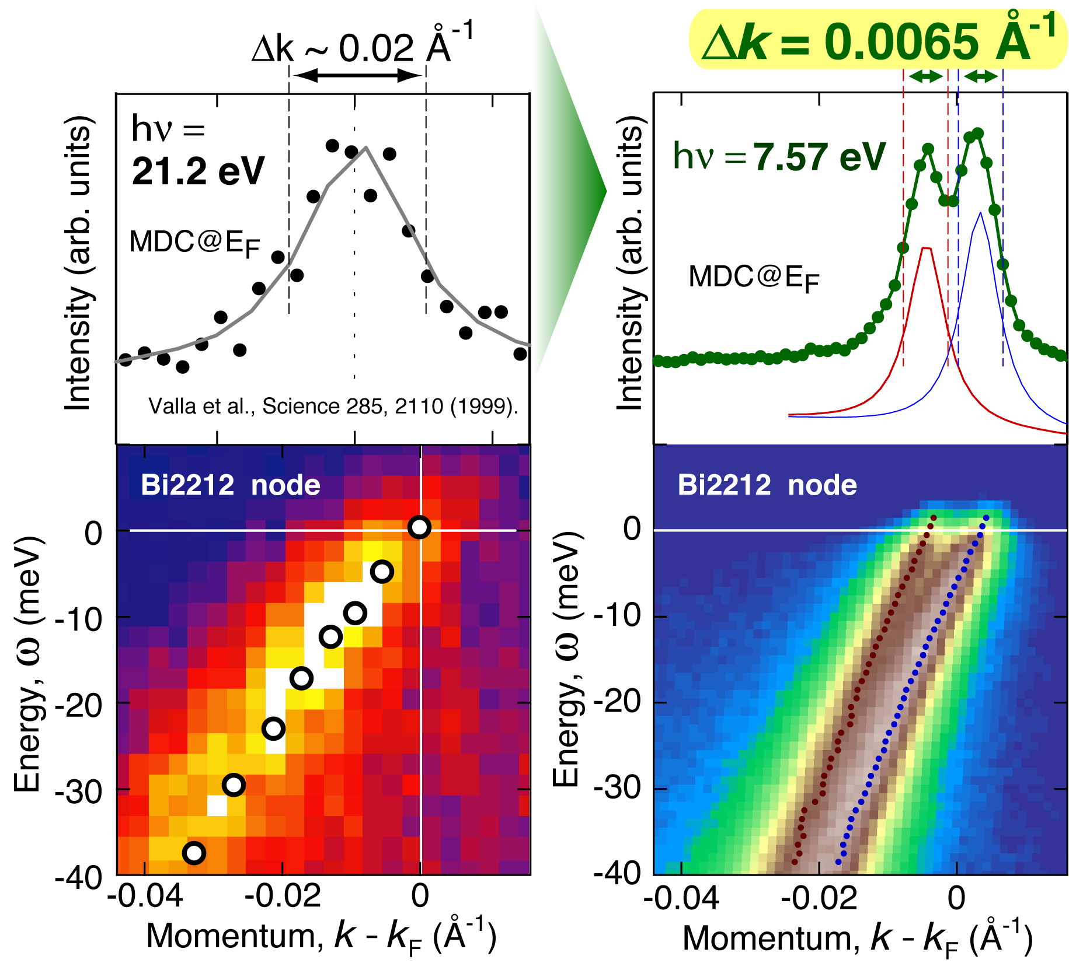
Observation of Bilayer Splitting
Advantage of High Energy- and Momentum-Resolutions !

Slide 17
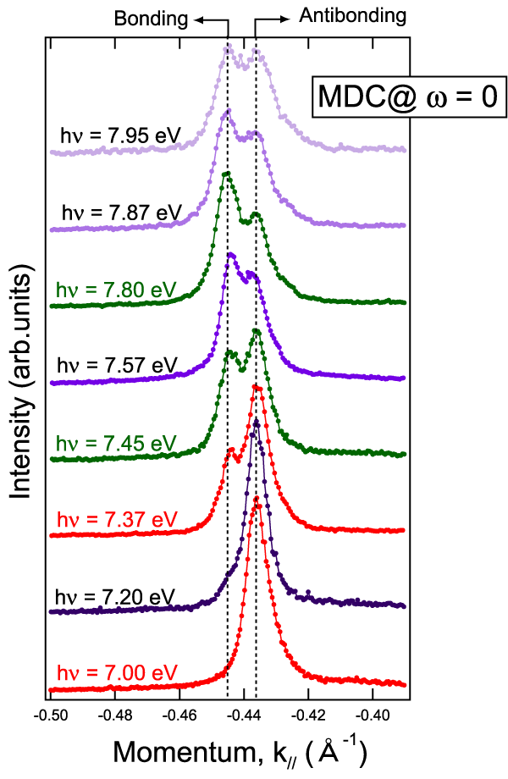
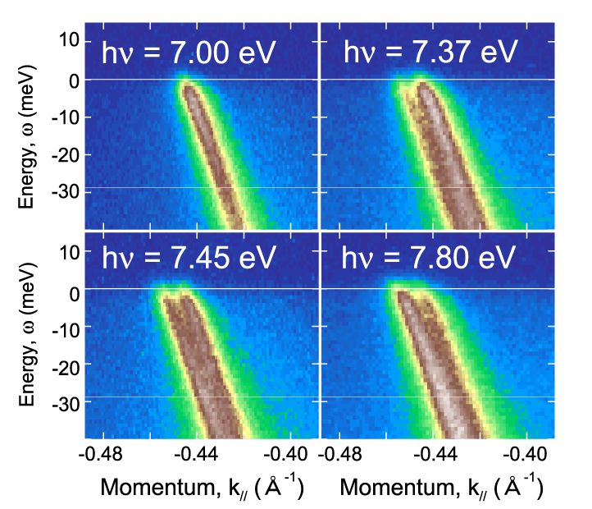
Photon energy dependence
-matrix element effect-
Advantage of SR Tunability !

Slide 18

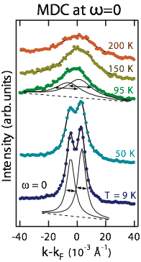
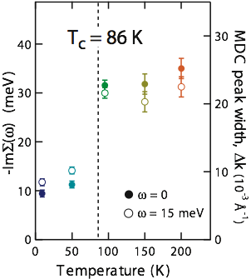
Temperature dependence
Nodal scattering rate
Scattering-rate suppression below Tc

Slide 19
Advantage of Low-Energy SR Photoemission Spectroscopy
hν < 15 eV
Bulk Sensitivity
Escape depth ~ 50 Å (kinetic energy ~4 eV)
  • Information intrinsic to bulk
High energy and momentum resolutions
∆E _{tot} : 600-700 μeV ∆k : 4×10⁻³Å⁻¹
• Fine structures near the Fermi level
Tunability of excitation photons
∆E _{ph} : 230 μeV @ 7 eV
• Selective observation of specific electronic
states using matrix-element effect

Slide 20
Future Perspectives
☆Fine adjustment of electron energy analyzer
☆Extreme low temperature using ³He refrigerator
☆Introduction of additional tools such as PEEM, STM
☆Fabrication and characterization of nano-structures

Slide 21
共同研究者
（HiSOR・広大院理）
有田将司、仲武昌史、澤田正博、井野明洋、島田賢也、佐藤仁、
生天目博文、谷口雅樹、
山崎達也、加茂剛、山崎健太郎、安斎太陽、吉河訓太、辻憲一朗、
東口光晴、三浦雄一、飛田尚寿、崔小宇
(広大総合科学) 小島健一、(愛媛大工) 平岡耕一
(東大新領域) 藤森淳、(Stanford University) Z.-X. Shen
(東大理) 石角元志、藤田和史、内田慎一、(産総研) 相浦義弘、永崎洋
(JASRI/SPring-8) 池永英司、小林啓介
(理研/SPring-8)
高田恭孝 、玉作賢治、西野吉則、三輪大五、矢橋牧名、石川哲也
(理研/SPring-8、東京大学物性研究所) 辛埴
(原研/SPring-8) 竹田幸治

Slide 22
Experiences on Beamline
Dedicated for
High Energy- and Momentum-Resolution ARPES
Hardware
Optimun integration of performances on light source, beamline and end station
Light source ⇔ High flux from insertion device
Beamline ⇔ Normal incidence monochromator and Light from
helical undulator to reduce heat load on optics
End station ⇔ System fixed to the beamline,
Development of relevant apparatus such as He refrigerator,
5-axex manipulator, sample preparation units etc..
Software
☆ Concentration of scientists for construction and development of researches
☆ Collaboration with excellent scientists over the world
☆ Flexible beam time like laboratory

